Slide 1
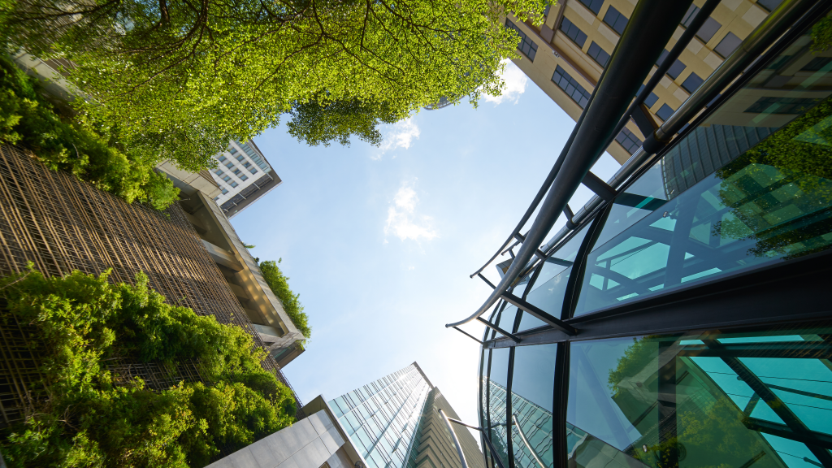
A brief overview of current rental situation, market conditions, scenario breakdown and strategic recommendations.

Slide 2
Project name / City, country
EXECUTIVE SUMMARY
Market Rent
XX – XXX €
ERV (combined)
-6.25 %
Vacancy Rate
XX.X %
Market strategy
LL friendly
Current situation
Idemia’s portfolio is located within the Manyata campus and staggered across 4 buildings within the park with latest space take up in Q3 2017 (Building M2). Vacancy rates are as low as 3%. Space is in high demand and leased quickly. Rents are expected to continue to rise here over the next 12 months.
Critical dates summary.
Current lease situation.
Strategies & recommendations
With the rising rents and infrastructure issues in the Eastern quadrant of the Outer Ring Road, North Bangalore has become a preferred destination for many IT companies (e.g. Cerner, Synechron, IBM). Idemia may also consider relocation of its operations. If so, we would recommend North Bangalore (Hebbal, Bellary Road, Thannisandra) as an alternate market to Idemia. Key Highlights of the market are :
Emerging micro market for future development
Developed infrastructure
Total stock – 728k SqM
Lease Expiry | 28/02/2023
Leased Area | 2,408 sqm
Rent | € 0.6 m / year
Timeline & actions
Scenario Description | 2020 | 2021 | 2022 | 2023 | 2024 | 2025 | 2026 | …
Phase 1: BB Centrum
Phase 2: Metronom
BB Centrum(2.4K SM) – 110 Seats
New Smaller CBD HUB or Consolidate –
Flexible Lease Metronom
PRG03 Go to Market Strategy
Metronom (29.3 K SM) 1,765 HC
Renew Right-size / New site
Consolidation Completed from 3/1/2023
Expire 9/30/2026

Slide 4
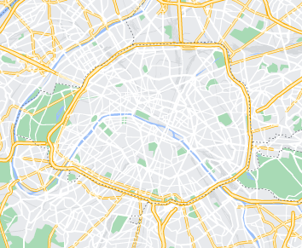
Building Name
BUILDING OVERVIEW
123 Address Ln. City | State | 56789
Asset Type | Office (PRA03)
Landlord Profile | Private, Institutional etc.
Occupation | c. 15% of the building
Construction Year | 2005
Last Upgrade | 2018
Lease Expiry | 28/02/2023
Notification Date
Total Size (sqm) | 16,500 sqm
Leased Area (sqm) | 2,408 sqm
Workplaces | 116 pcs
Average Utilisation | 34% (37 out of 123 HC)
Building Vacancy
Current Listing Rent
Rent | € 0.6 m per year
Service Charges | € 0.1 m per year
The property is located in a very well established office area in Prague, and is well set up with amenities including restaurants, a gym and other services
The office is approximately 8 minutes from the nearest metro station
Market rents are in the region of €186 – €310 per sqm per annum
There is 50,000 sqm of vacancy in the submarket which is impacted by the anticipated delivery of c. 18,000 sqm of new office space
Furthermore, there is a pipeline of new developments totalling 16,000 sqm
Rents are forecast to remain stable or increase due to higher construction costs and a lack of supply
Notes:
New development

Slide 5
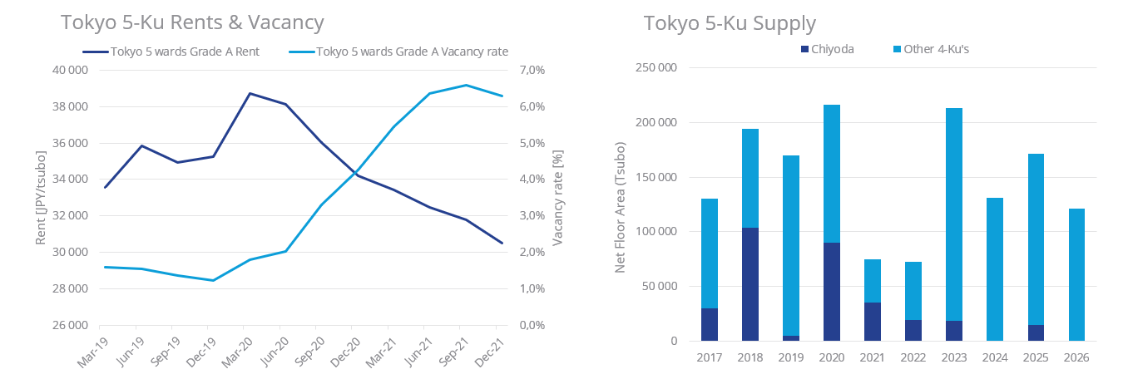
MARKET OUTLINE
Rent & Vacancy vs Supply (City level)
Implication for Company
Market comments
Market comments
Comments based on client’s situation
Comments based on client’s situation
Rent & vacancy
Supply or Rent per district
Insert map with submarkets

Slide 6



MARKET RENTS & VACANCY IN SUBMARKET
Implication for Company
Ebisu Green Glass Building has had little vacancy, so rents have only fallen slightly. That said, Idemia’s current rent is ~10% higher than a new tenant’s moving into the building. There is great leverage to negotiate for a rent reduction at lease expiration.
Current Rent:
¥32,000
Rental Change (Y0Y):
-6.25 %
Asking Rental:
¥28,000 – 30,000
Vacancy Rate:
0.0%
Grade-A Tokyo 5-Ku Vacancy and Rent vs. Shibuya-ku
123 Address Ln. City | State | 56789
List Price | $500M
Sale Price | $500M
Vendor | Company Name
Building Area | 60,000 SQM
Purchaser | Company Name
Sale Date | October 1, 2021
Detail 1-2 recent deals to compare
123 Address Ln. City | State | 56789
List Price | $500M
Sale Price | $500M
Vendor | Company Name
Building Area | 60,000 SQM
Purchaser | Company Name
Sale Date | October 1, 2021

Slide 7
To be developped during/at end of project.
SCENARIOS & FINANCIAL MODELING
 | Scenario 1 STAY – Full renovation | Scenario 2 STAY – Partial renovation | Scenario 3 MOVE – Disposal & Rental
Objectives / Hypotheses | Annual charges and maintenance cost comparison with potential rental relocation P&L : 190k€ of annual amortization | Annual charges and maintenance cost comparison with potential rental relocation P&L : 190k€ of annual amortization | Current annual rent approx. 300k€ max. Penalty for Surrender (including 12-18 months incentives for New Tenant : approximately 2.500 K€
Recurring OPEX | Annual charges and maintenance cost comparison with potential rental relocation P&L : 190k€ of annual amortization | Annual charges and maintenance cost comparison with potential rental relocation P&L : 190k€ of annual amortization | Current annual rent approx. 300k€ max. Penalty for Surrender (including 12-18 months incentives for New Tenant : approximately 2.500 K€
CAPEX | Estimated renovation costs Colliers able / unable to challenge | Estimated renovation of 90k€ (Idemia’s input – air conditioning only) | Cost of relocating is unknown at this stage
Savings | Compare against relocation (rental location?) costs Detail savings Detail savings | To be compared with a rental location | Expected sale price around 1 to 1.2m€ according to local Colliers’ broker Asset estimated price 2020 : 2M€ Asset estimated price 2021 : 1-1,2M€ (as is)
Warning Points | Site not attractive to employees / Unsafe environment | Site not attractive to employees / Unsafe environment | Difficulties expected to sell the asset / probably
Financial comparison
of scenarios.

Slide 8
To be developped during/at end of project.
SCENARIOS & FINANCIAL MODELING
 | 1 STAY Full renovation | 2 STAY Partial renovation | 3 MOVE Disposal & Rental
Objectives / Hypotheses | Annual charges and maintenance cost comparison with potential rental relocation P&L : 190k€ of annual amortization | Annual charges and maintenance cost comparison with potential rental relocation P&L : 190k€ of annual amortization | Current annual rent approx. 300k€ max. Penalty for Surrender (including 12-18 months incentives for New Tenant : approximately 2.500 K€
Recurring OPEX | Annual charges and maintenance cost comparison with potential rental relocation P&L : 190k€ of annual amortization | Annual charges and maintenance cost comparison with potential rental relocation P&L : 190k€ of annual amortization | Current annual rent approx. 300k€ max. Penalty for Surrender (including 12-18 months incentives for New Tenant : approximately 2.500 K€
CAPEX | Estimated renovation costs Colliers able / unable to challenge | Estimated renovation of 90k€ (Idemia’s input – air conditioning only) | Cost of relocating is unknown at this stage
Savings | Compare against relocation (rental location?) costs Detail savings Detail savings | To be compared with a rental location | Expected sale price around 1 to 1.2m€ according to local Colliers’ broker Asset estimated price 2020 : 2M€ Asset estimated price 2021 : 1-1,2M€ (as is)
Warning Points | Site not attractive to employees / Unsafe environment | Site not attractive to employees / Unsafe environment | Difficulties expected to sell the asset / probably
Financial comparison
of scenarios.
Notes:
4 steps

Slide 9
Rent and Vacancy Trends
9
PRELIMINARY FINANCIAL ANALYSIS
Not mandatory at stage of preliminary analysis, but even better if possible.
Use local template.
5-Year Analysis
Area (Tsubo / SQM) | 125.48 / 414.28 | 125.48 / 414.28 | 10 – seats | 15 – seats | 21 – seats
Rent (JPY/Tsubo) | JPY 32,000 | JPY 30,000 | JPY 105,000/seat | JPY 105,000/seat | JPY 105,000/seat
Free Rent | 0 months | 0 months | 2 months | 2 months | 2 months
Cost Change* | 0.0% | -6.0% | -64.4% | -51.7% | -39.1%
TOTAL 5-Year - Euro | € 1,750,173 | € 1,645,424 | € 623,884 | € 844,898 | € 1,065,913
Serviced seats cost JPY 105,000/Seat/Month
Euro/JPY Exchange = 138

Slide 10
STRATEGY NOTES / DISCUSSION
Estimated project start date: DD/MM/202X
Important considerations for Stay-vs-Go Analysis
Idemia is currently over-rented in the building (32,000/Tsubo/Month vs. 28K-30K for new tenants)
With a headcount of 21, and office size of 125 Tsubo, the office density is ~6 Tsubo/HC. Standard density in Tokyo for multinational corporates is ~3-4. Idemia is likely in too much space based on Tokyo standards assuming a typical office us.
Lease expiration is May 31st 2023, 9-months away. This is not enough time for a full relocation project to another dedicated office unless Idemia could take over a previous tenants existing fitout. This is enough time for a relocation to a serviced office.
Colliers could very likely achieve cost savings through recontract negotiations with the landlord if Idemia decides to stay in the current space, but this negotiation should kick-off immediately so relocation is still feasible and threat of relocation can be used as leverage.
A relocation to serviced will result in cost-savings, but it needs to fit the business needs for Tokyo. This costs savings cost range from ~40% - 70% depending on number of desks, if drop-in passes are required, and which center is selected (as desk rates can range from 70,000/Seat – 150,000/seat).
Idemia has a 6-month termination notice, so exiting the current space would require a notice sent to the landlord by Nov. 30th 2022. This means the deadline for an approved decision of relocation is prior to this.
Relocation will require reinstating the current office back to white box at Idemia’s expense. This cost is an upfront cost to relocate and needs to be considered in the stay-vs-go decision. Reinstatement would roughly cost JPY 200,000/Tsubo (JPY 25,096,000 – EU 185K).

Slide 11
TIMELINE SAMPLE
Estimated duration per project stage
Month 1 | Month 2 | Month 3 | Month 4 | Month 5 | Month 6 | Month 7 | Month 8 | Month 9 | Month 10 | Month 11 | Month 12
Long list development
Adapt to local project if necessary / replace with local template.
Relocation Shortlist & Property tours
RFP development, submission, negociation
Qualitative & quantitative Analysis, Test Fits
Stay vs. Go decision and/or LOI Submission
Lease Language & Approvals
New Lease execution
Design & Technical DD
Procurement
Lease commencement
Fitout
Move
Lease expiry
6-month Termination Notice
Reinstatement
Notes:
Process, monthly gantt chart, infographic

Slide 12







12
LOCAL MARKET PRACTICES
Adapt to city market
What makes **city** a unique market ?
Lease terms
Renewal terms
Exit clause
Security deposit
Two types:
Standard or Traditional 2-year “auto-renewing” Japanese lease
Fixed term lease, usually 3-5 years
Fixed term lease currently preferred by most landlords of Grade-A offices but prevailing market conditions can impact on lease flexibility
Traditional Japanese leases are auto-renewing and rent increases/decreases only occur when the landlord or tenant makes a formal request, and an agreement is met.
Fixed term leases have no automatic right to renew. Re-contract is required, and typically result in rent to market rate levels.
Traditional leases give tenants automatic right to terminate (usually with 6 month’s notice) and security of tenure (Section 28 of House & Lease Law).
Fixed term leases do not contain a right to terminate but landlords are becoming more flexible to include break clauses etc. via negotiation on a case-by-case basis.
Up to 12 months headline rent, typically paid in cash without interest.
Balance kept in landlord’s account and returned net reinstatement costs.
Deposit amount typically increased to match proportionate increase in rent at lease recontract.
Reinstatement
Fit-out
Alienation
Space standards
Tenants are required to restore the space to the original condition at lease expiration at tenants expense.
Regular office estimate → JPY 200,000 per tsubo (US$50 per sq ft)
Tenants pay all fitout costs and are typically required to use the landlord’s nominated contractor for the majority of build-out work.
Regular office estimate cost JPY 800,000 – 1,500,000 per tsubo (US$ 177 - 332 per sq ft)
Subleases are very rare, but in situations when they are allows, tenants may typically share with group companies under the same corporate umbrella.
Domestic companies: 2-4 tsubo (70-140 sqft) / person
Multinationals: 3-5 tsubo (100-180 sqft) / person
Legal Firms: 4-6 tsubo
(140-210 sqft)/person

Slide 13

Firstname Lastname
Title
+1 555 555 5555
firstname.lastname@colliers.com
Firstname Lastname
Title
+1 555 555 5555
firstname.lastname@colliers.com
Firstname Lastname
Title
+1 555 555 5555
firstname.lastname@colliers.com
Amend local & central contacts accordingly
Firstname Lastname
Title
+1 555 555 5555
firstname.lastname@colliers.com
Firstname Lastname
Title
+1 555 555 5555
firstname.lastname@colliers.com
Firstname Lastname
Title
+1 555 555 5555
firstname.lastname@colliers.com
This document has been prepared by Colliers for advertising and general information only. Colliers makes no guarantees, representations or warranties of any kind, expressed or implied, regarding the information including, but not limited to, warranties of content, accuracy and reliability. Any interested party should undertake their own inquiries as to the accuracy of the information. Colliers excludes unequivocally all inferred or implied terms, conditions and warranties arising out of this document and excludes all liability for loss and damages arising there from. This publication is the copyrighted property of Colliers and/or its licensor(s). ©2022 All rights reserved. Colliers International Group Inc.

